Slide 1
Project Analysis MSIS 615 BUSINESS PROGRAMMING BY Anvita Rayala

Slide 2
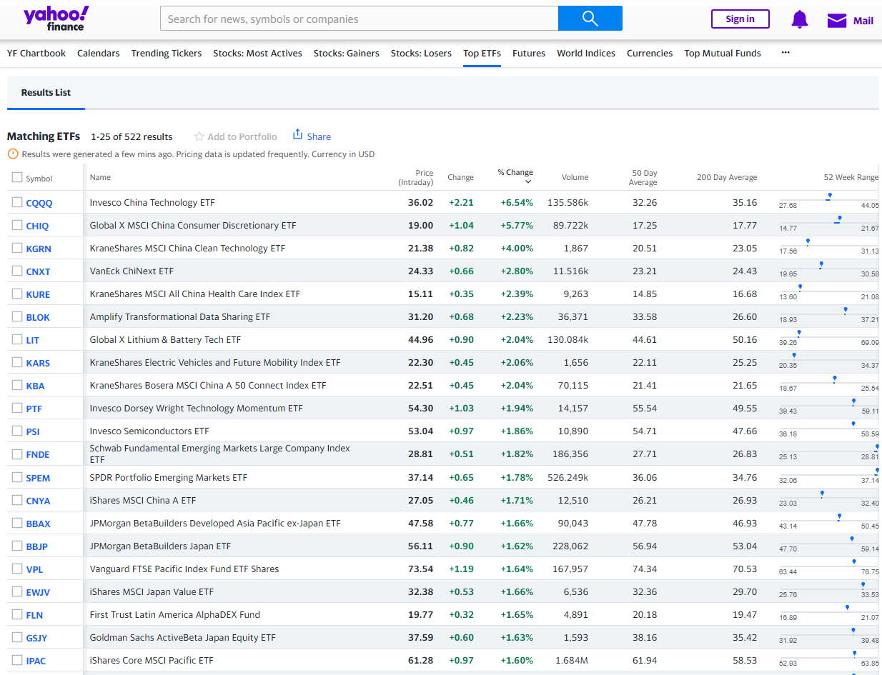
Project analysis slide 4
Introduction
Yahoo Finance?
Weblink - https://finance.yahoo.com/etfs/
What are ETFS?
Why this website?

Slide 3

Project analysis slide 4
Web crawling
What is Web – Crawling
Steps to crawl
Identify the webpage
Extract the content
Regular Expression (RE Package).
Beautiful Soup.
Save the results
Into a database.

Slide 4
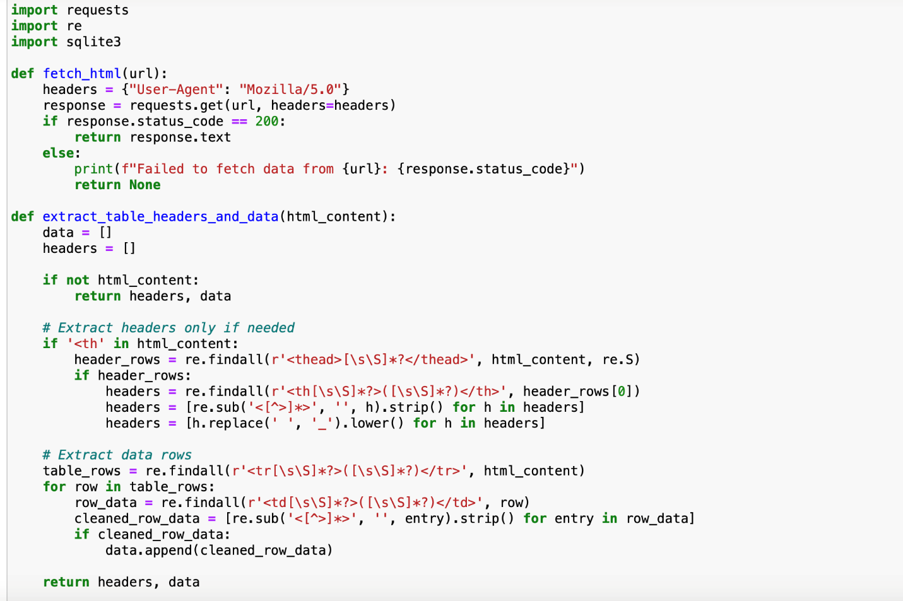
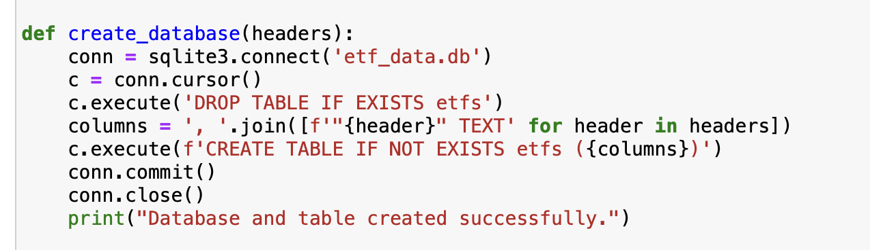
Project analysis slide 4
Web crawling
The python script fetches HTML content from the url https://finance.yahoo.com/etfs/
It extracts table headers and data from the HTML content.
We have used regular expressions and requests package for the data extraction.
The script shown in the second screenshot creates a database named etf_data.db to store the scrapped data.

Slide 5

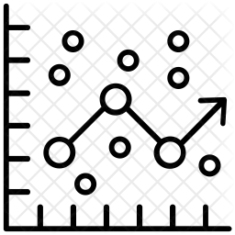
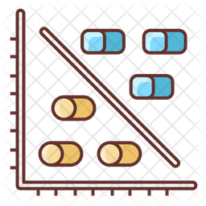

Project analysis slide 3
Project Analysis
DESCRIPTIVE
ANALYSIS
REGRESSION
ANALYSIS
VISUALIZATION
CLUSTER
ANALYSIS
Statistical Model that uses historic data to identify patterns and relationships
Set of statistical methods used for the estimation of relationships between a dependent variable and one or more independent variables.
Visual representations of data to analyze datasets and help users identify patterns.
Statistical method that groups objects based on how similar they are to each other.

Slide 6
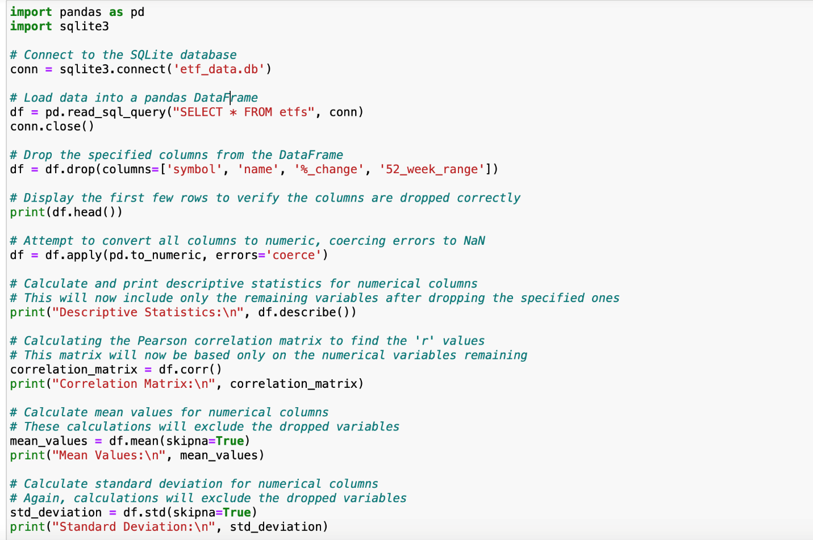
Project analysis slide 4
Descriptive Analysis
Established connection to an SQLite database named 'etf_data.db’.
Loaded data from the 'etfs' table in the SQLite database into a Pandas data frame (‘df’).
Dropping specific columns ('symbol', 'name', '%_change', '52_week_range') from the data frame since we had many NaN values.
Calculated and printed the descriptive statistics for numerical columns in the data frame.

Slide 7
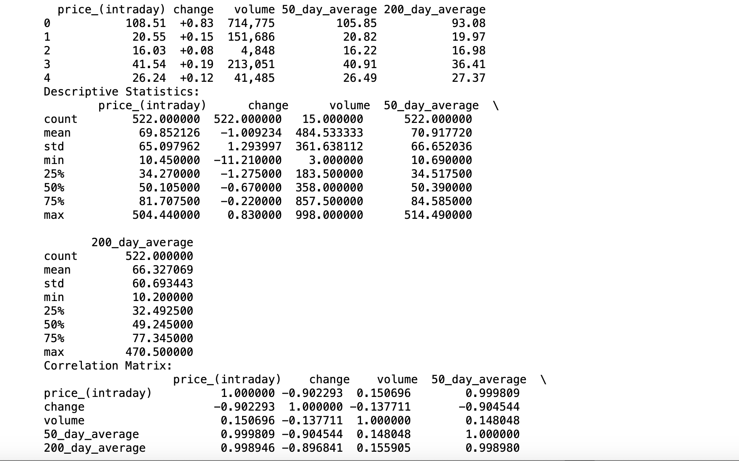
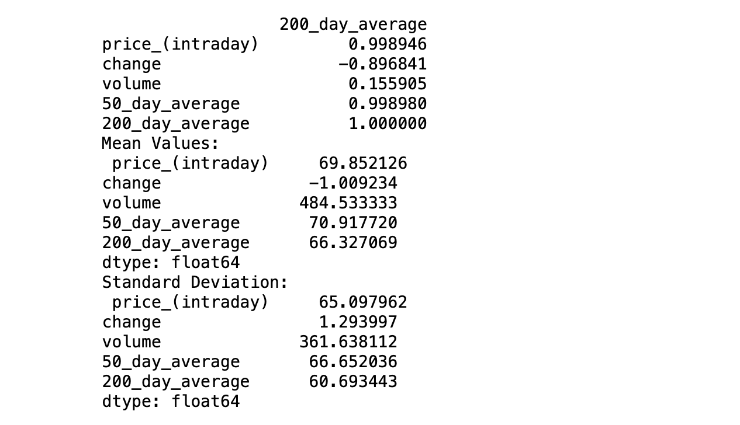
Project analysis slide 4
Descriptive Analysis

Slide 8
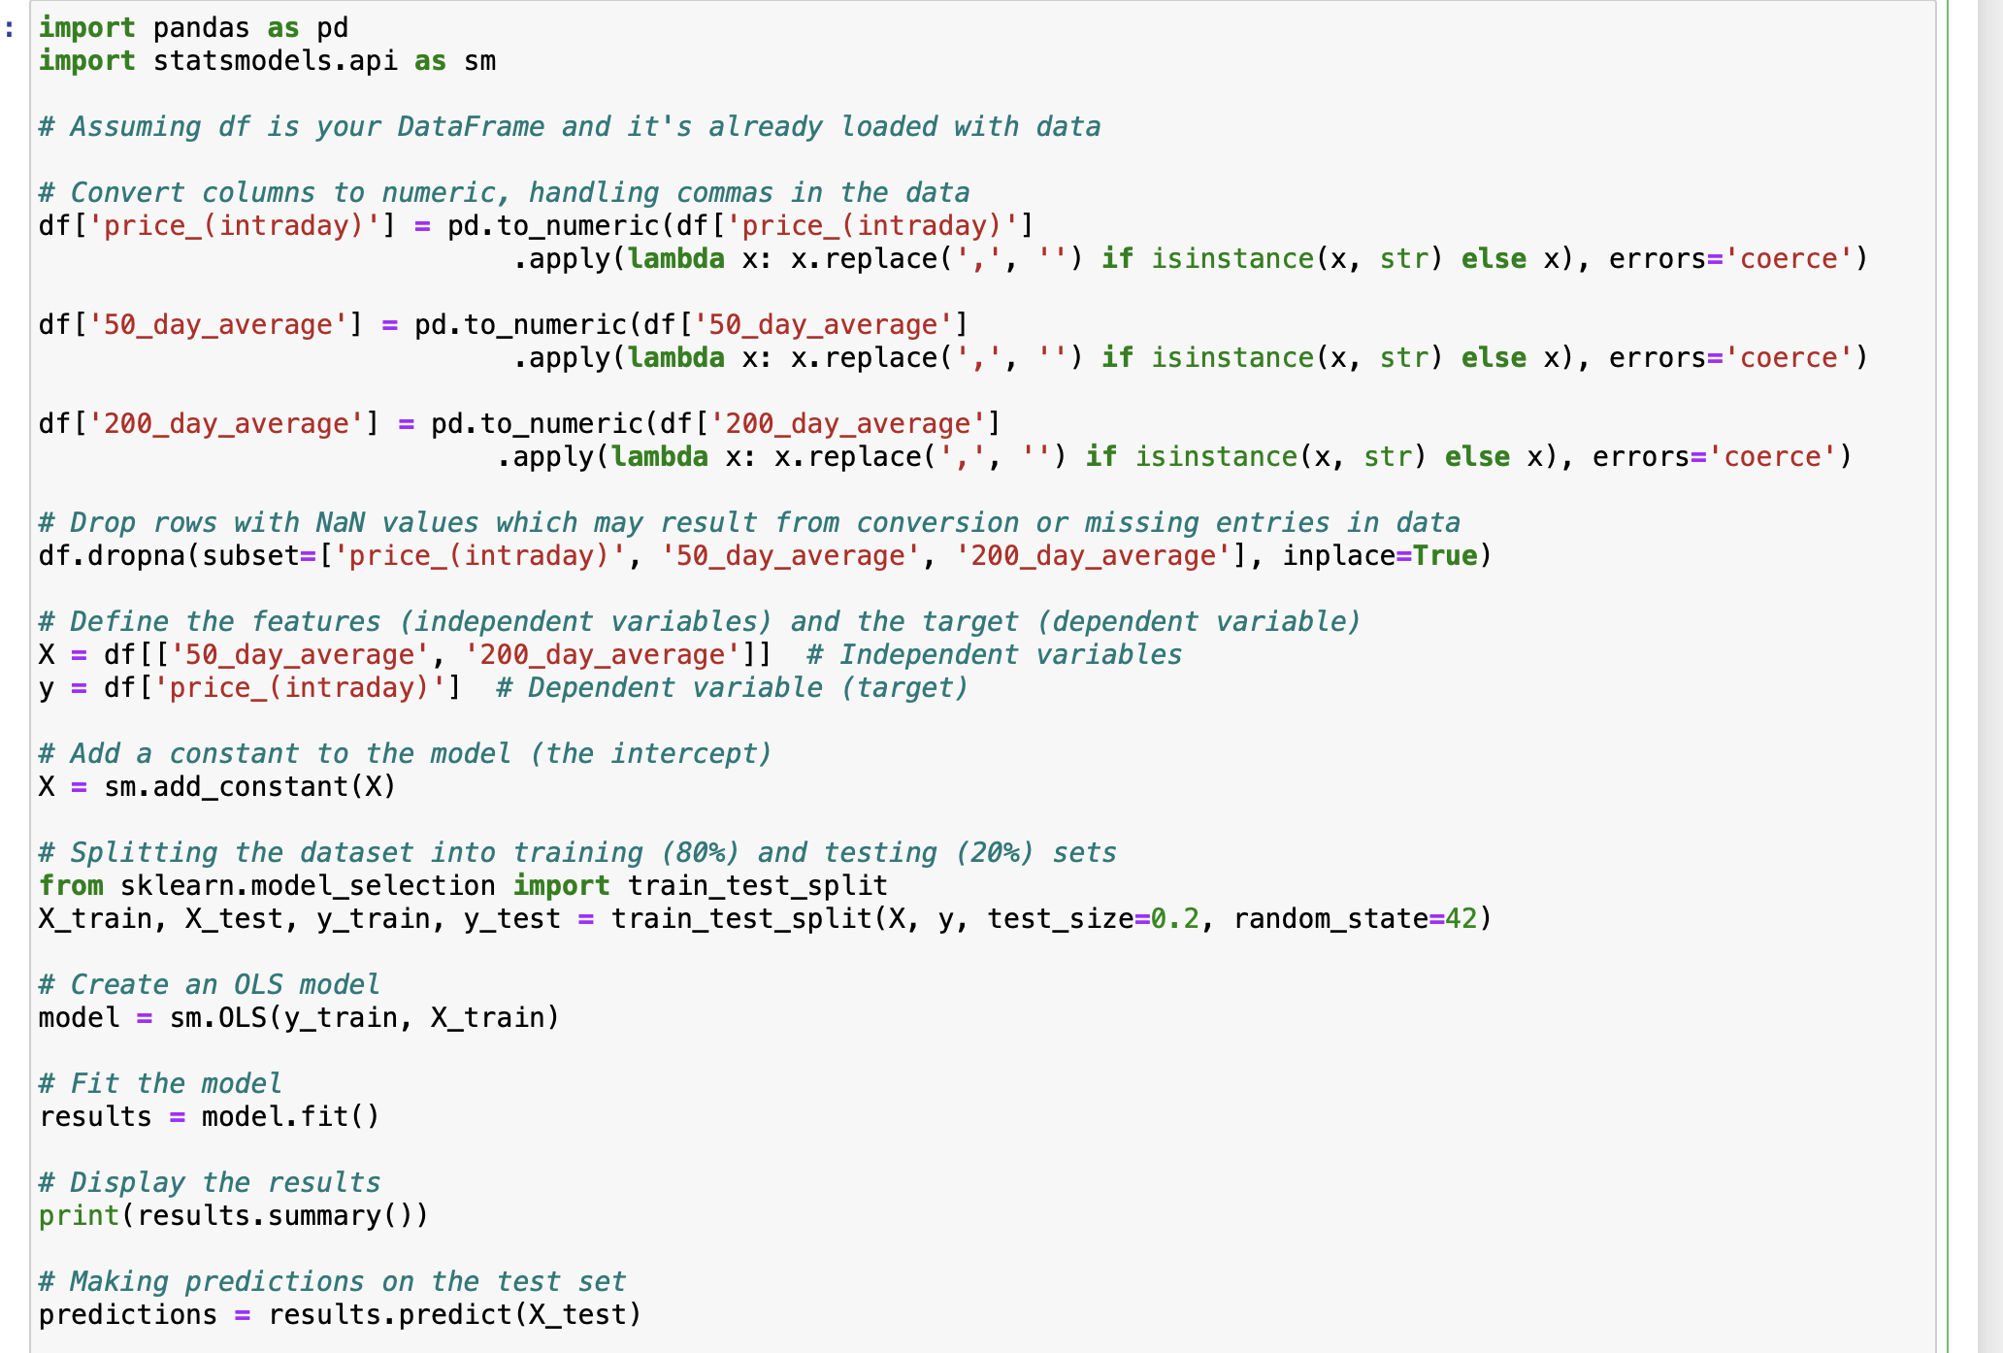
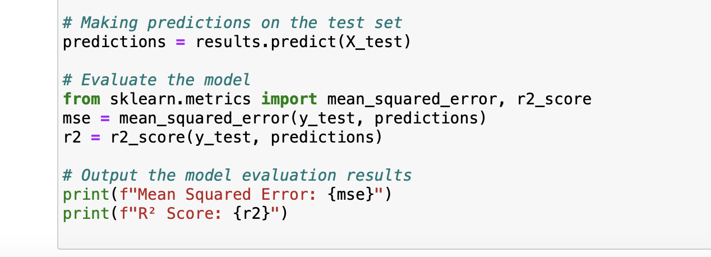
Project analysis slide 4
Regression Analysis
Convert price_Intraday, 50_day_average, and 200_day_average to numeric, removing commas.
Drop rows with NaN values in these critical columns.
Independent variables (50_day_average, 200_day_average) and the dependent variable (price_Intraday).
Divide data into training (80%) and testing (20%) sets using a random state for reproducibility.

Slide 9
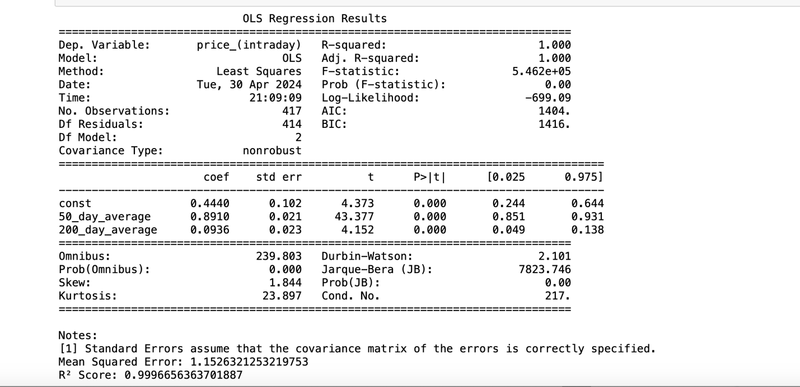
Project analysis slide 4
Regression Analysis
Perfect prediction of intraday prices using 50-day and 200-day averages.
R-squared of 1.00 indicates a highly significant model fit.
Extremely large F-statistic underscores this significant fit.
Analysis highlights the strong relationship between moving averages and intraday ETF prices.
Demonstrates the model's robustness and predictive accuracy.

Slide 10
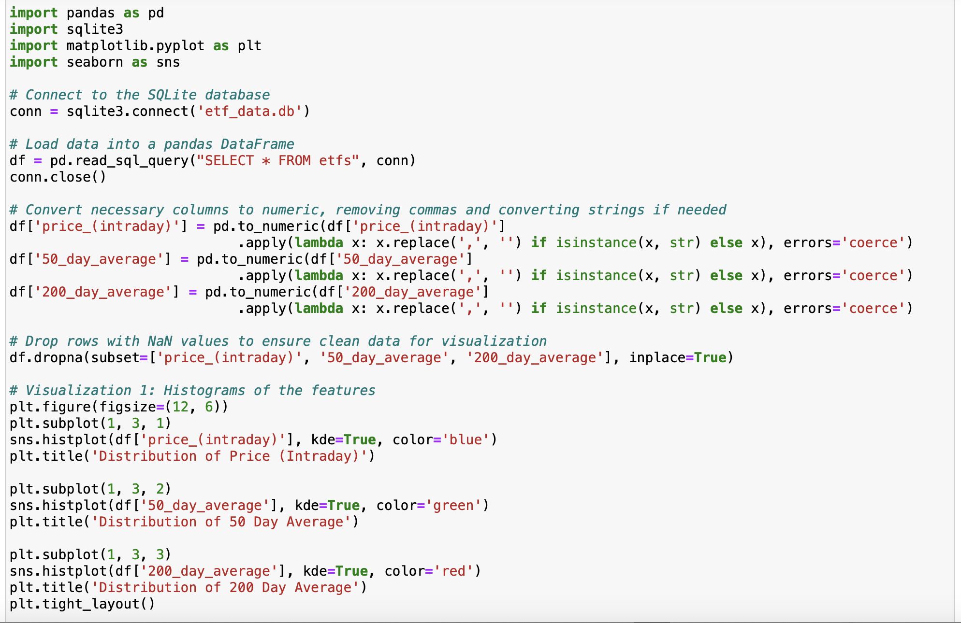
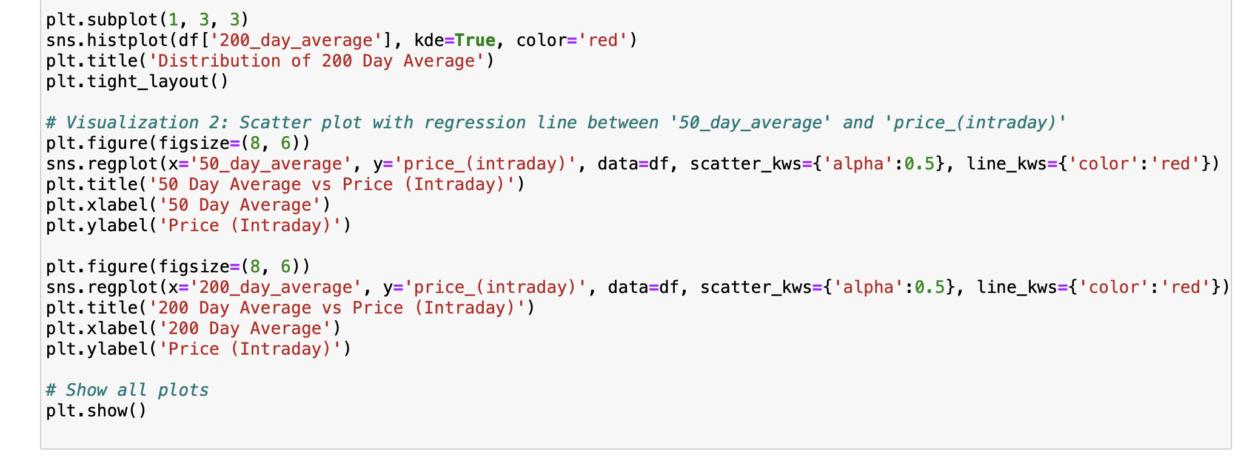
Project analysis slide 4
Visualization
Visualization
Ensured that relevant columns are numeric.
Converted string data into numeric if necessary and dropping specific rows with NaN values.
Histogram
Scatter plot(Price Vs 50 Day Avg)
Scatter plot(Price Vs 200 Day Avg)

Slide 11
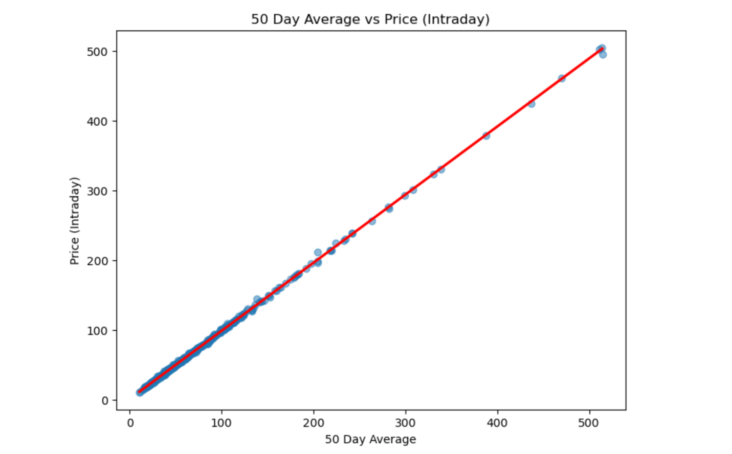
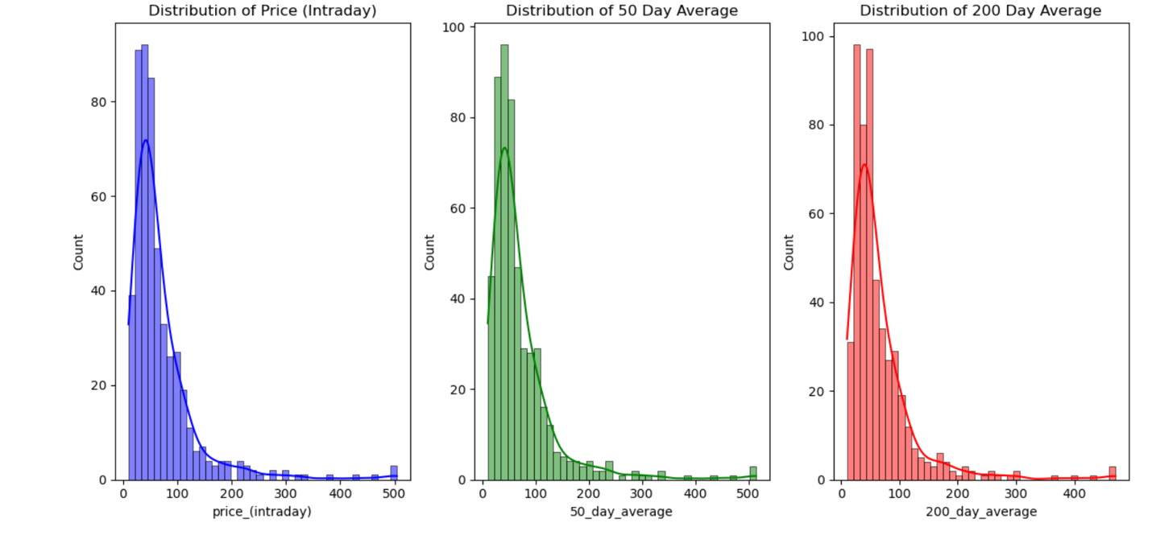
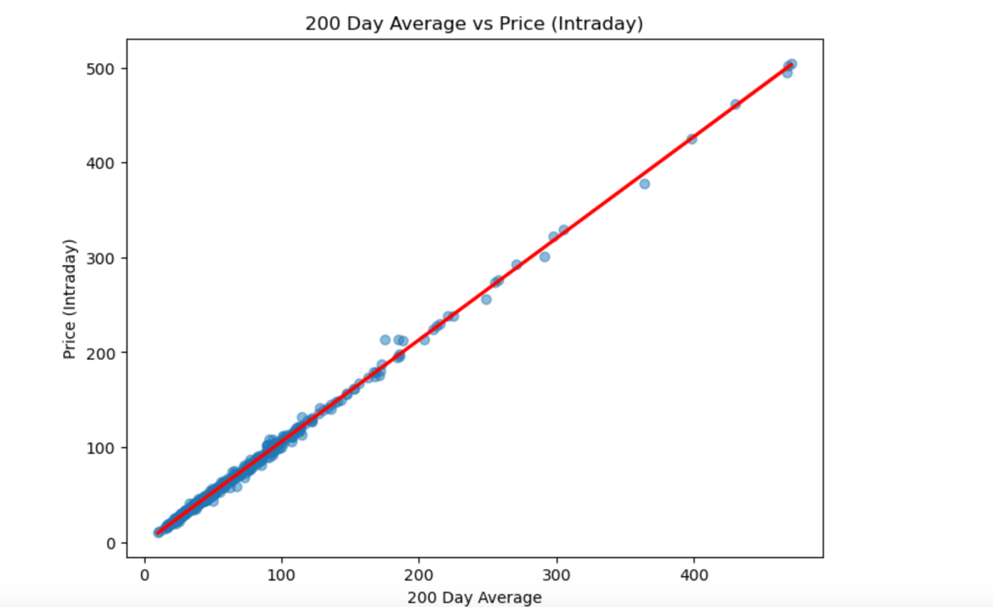
Project analysis slide 4
Visualization
Visualization
Scatter
Plot
Histograms

Slide 12
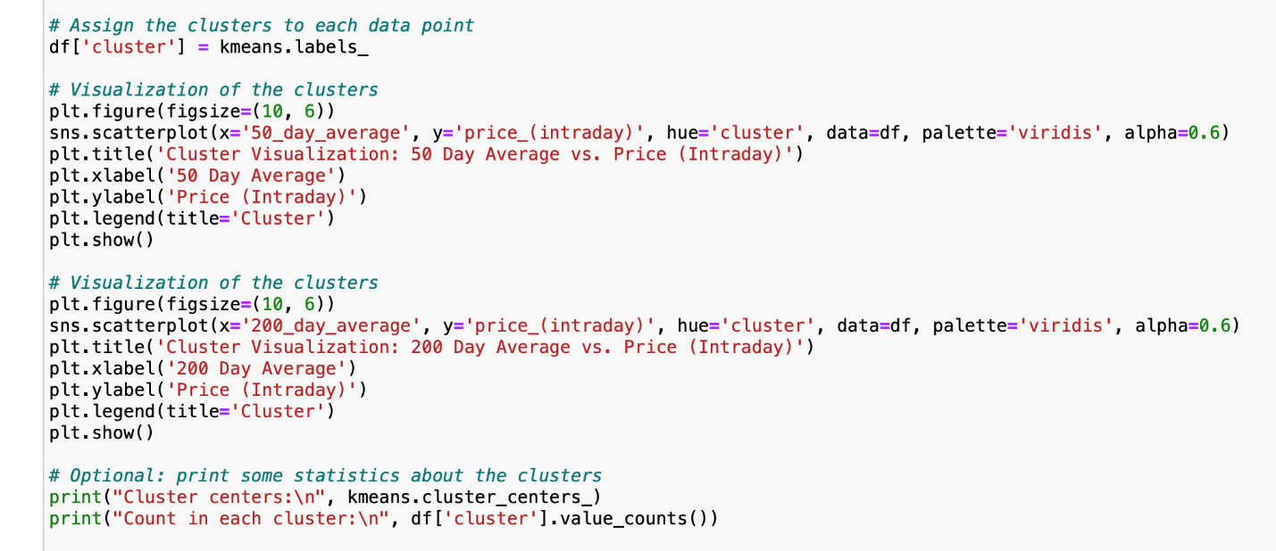
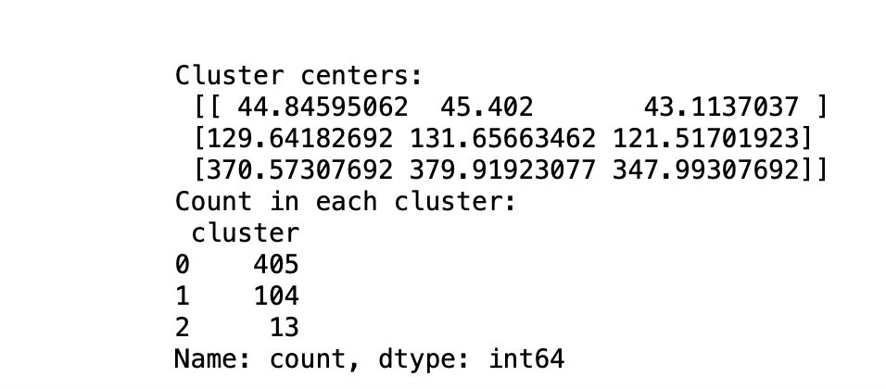
Project analysis slide 4
Cluster Analysis
Title: Assigning Clusters to Data Points
Cluster analysis is a statistical technique used to classify objects or data points into groups, or "clusters," based on similarities among the objects.
The code utilizes the .labels attribute of kmeans object to assign a cluster label to each point present in the Data Frame.
This attribute essentially creates a new column named "cluster" within the Data Frame.
Each row in a table represents a cluster, and each column in the table represents a feature.

Slide 13
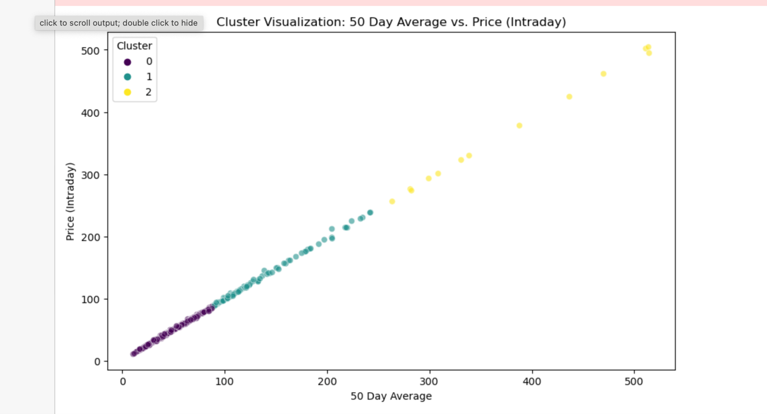
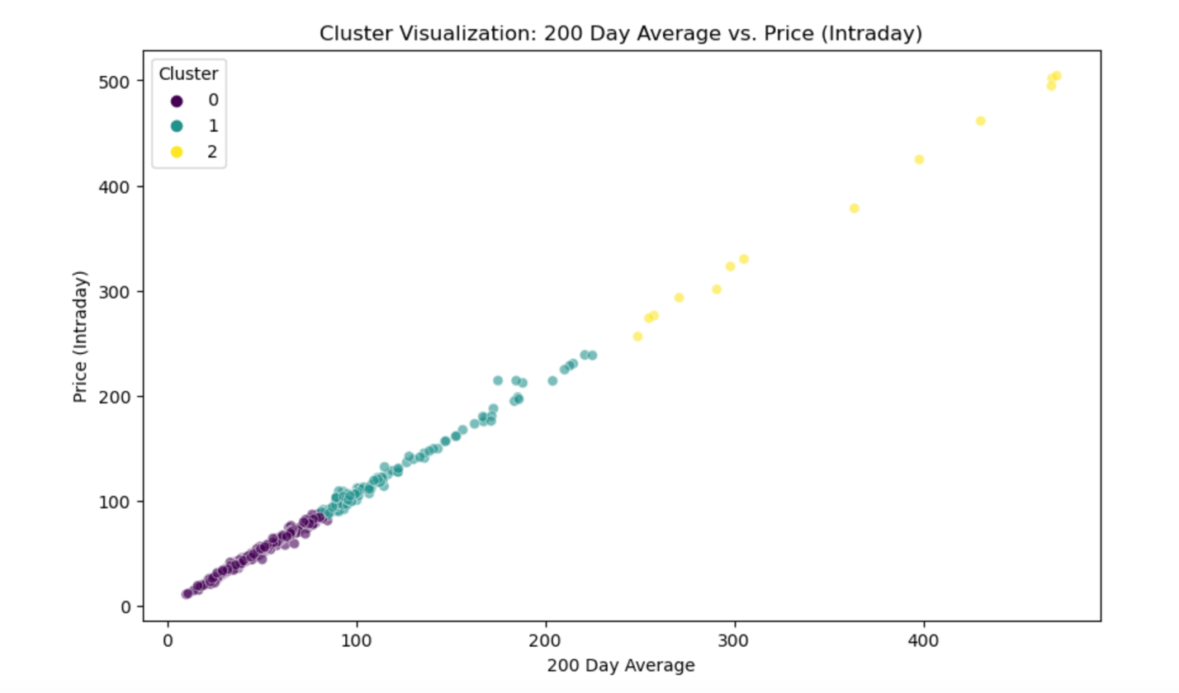
Project analysis slide 4
Cluster Analysis
50 Day Average vs Price (Intraday)
200 Day Average vs Price (Intraday)

Slide 14
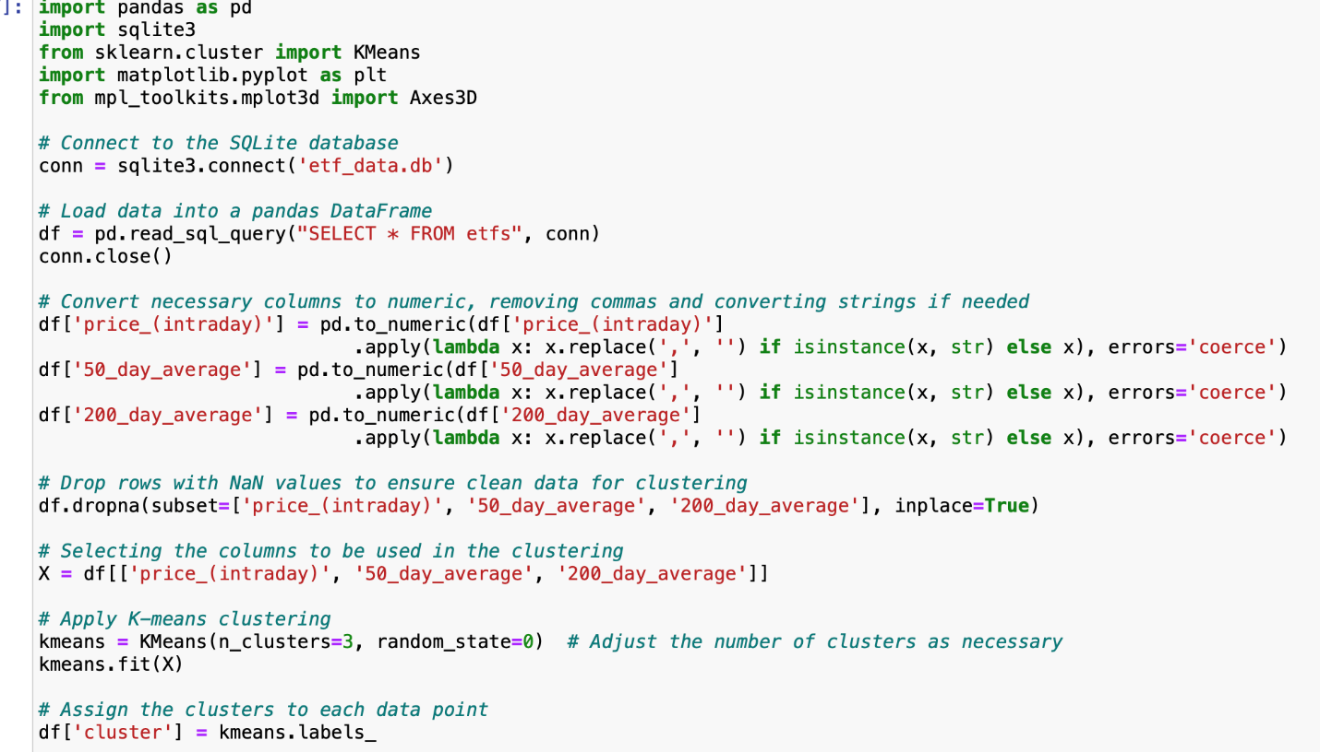
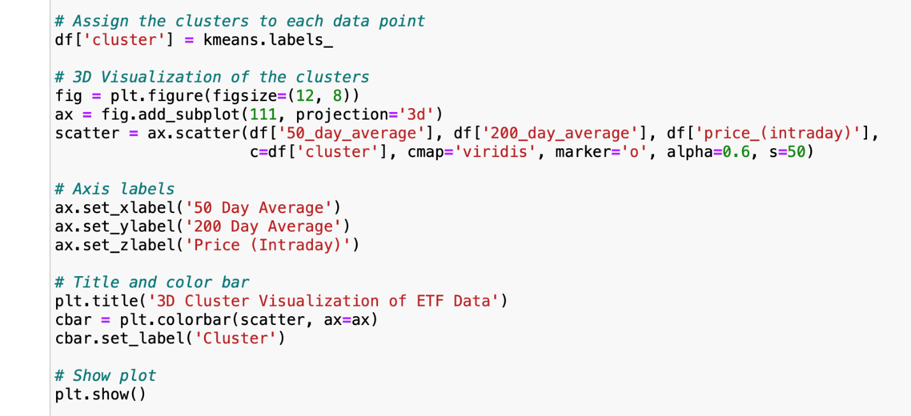
Project analysis slide 4
Cluster Analysis
The cluster analysis aimed to categorize the ETFs
The code included the financial data from a database.
Prepares data for analysis and ensures its numerical and removes missing values.
K-means clustering is applied.

Slide 15
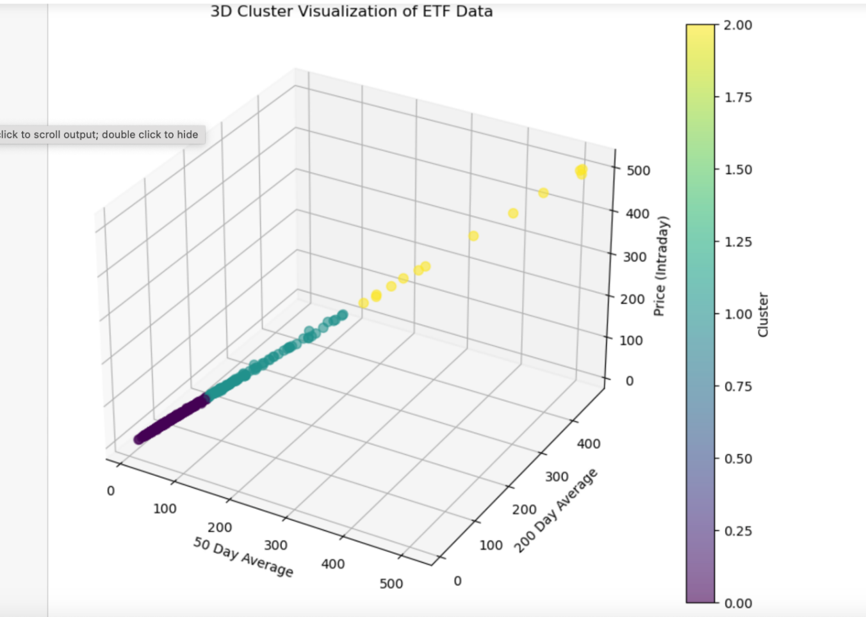
Project analysis slide 4
Cluster Analysis
A 3D scatter plot was generated, plotting the 'price_(intraday)', '50_day_average', and '200_day_average' on the three axes.
The categorization of ETFs into small, mid, and large-cap based on their average and daily price values.
This visualization provides a comprehensive view of the data distribution in three dimensions, allowing for a better understanding of the cluster separations.
50 Day Average vs Price (Intraday) vs 200 Day Average

Slide 16
Project analysis slide 4
Conclusion
Insight into Price Predictors: Understanding how 50-day and 200-day moving averages significantly predict intraday ETF prices.
Model Validation: Confirmation of the model's effectiveness through high statistical measures like R-squared and F-statistic.
Data Quality Awareness: Recognition of the importance of considering data distribution and the impact of outliers on predictive models.
Strategic Decision Making: Enhanced capability for financial forecasting and strategic decision-making based on robust statistical analysis.

Slide 17
Thank You

